Slide 1
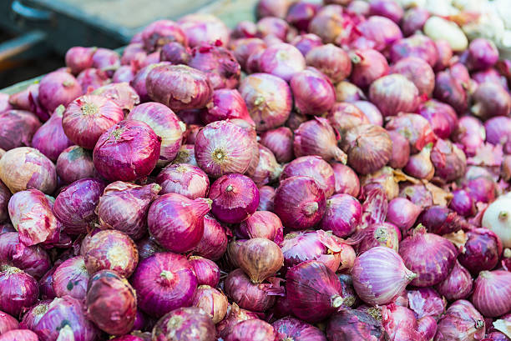
Onion Price Analysis And Forecasting
Uma Bhokare (2306)
Pravin Ahire (2301)
Department of Statistics
Savitribai Phule Pune University
Pune- 411007
Research Project

Slide 2
Outline
Slide 2
Introduction
Data Description
Analysis
Conclusion
Limitations and Future Scope

Slide 3
Introduction
1)Imagine the benefits of predicting the price of essential items like vegetables in advance. Vegetables, being a staple in every kitchen, have prices that significantly impact households, especially middle and lower-income families.
2) For farmers, accurate price forecasts can help optimize production, storage, and sales decisions, ensuring better profitability. Onion prices, known for their volatility, are influenced by factors such as climate, production costs, storage capabilities, and seasonal demand. This unpredictability affects both producers and consumers, highlighting the need for robust forecasting models.
3)Maharashtra, contributing over 30% of India’s onion production, is the largest producer in the country, with Pune district playing a key role in supplying high-quality onions for domestic and export markets. However, onion prices remain highly volatile due to climate, production costs, storage, and seasonal demand
4)Our project, "Onion Price Analysis and Forecasting," utilizes historical data (2013-2024) and advanced techniques like Time Series Models to predict onion prices.

Slide 4
Introduction (Objectives)
To identify seasonal variations and long term trends in price .
Develop a predictive model to accurately forecast onion prices using historical data
Analyse and compare onion price trends and volatility before and after the COVID-19 pandemic to assess its impact on the supply chain and market dynamics..

Slide 5
Data Description
The dataset used in this project consists of 1,44,098 observations and 8 variables, providing comprehensive information about onion market trends across various districts and markets in Maharashtra, India, from 2013 to 2024 also form this dataset we use Pune city data for our analysis Below is a brief description of the dataset's structure and variables:
District. Name: The name of the district where the market is located (e.g., Ahmednagar, Nashik).
Market. Name: The specific market within the district (e.g., Ahmednagar, Chandvad).
Variety: The type of onion traded, such as Other, Red, Local, White, and Hybrid.
Arrivals. Tonnes.: The quantity of onion arrivals in the market, measured in tonnes.
Min.Price..Rs..Quintal.: The minimum price of onions recorded in Rs./Quintal.
Max.Price..Rs..Quintal.: The maximum price of onions recorded in Rs./Quintal.
Modal.Price..Rs..Quintal.: The most common (modal) price of onions in Rs./Quintal.
Reported.Date: The date on which the prices and quantities were reported.

Slide 6
Literature Review
1) 1.Seasonal ARIMA to forecast fruits and vegetable agricultural prices
The paper focuses on applying Seasonal ARIMA (SARIMA) models to forecast agricultural prices of fruits and vegetables.
Seasonal and non-seasonal price variations pose significant challenges for stakeholders, such as farmers, traders, and policymakers.
SARIMA models are effective in capturing the seasonality inherent in agricultural price data, leading to improved accuracy in predictions
The study demonstrates SARIMA's capability to provide reliable forecasts for agricultural prices.

Slide 7
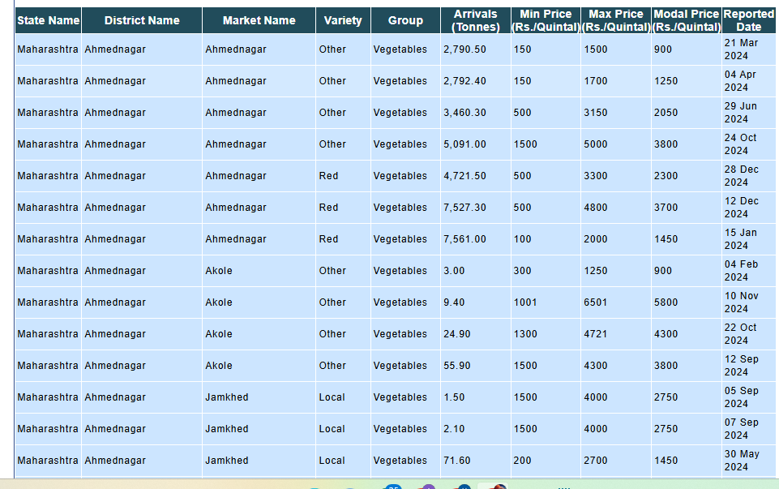
Exploratory Data Analysis
Source Of Data:- https://agmarket.gov.in
Visualization of Data

Slide 8
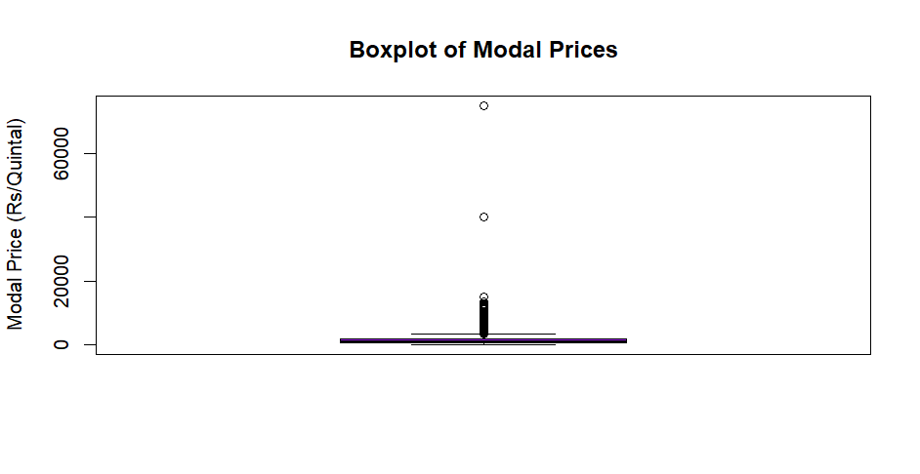
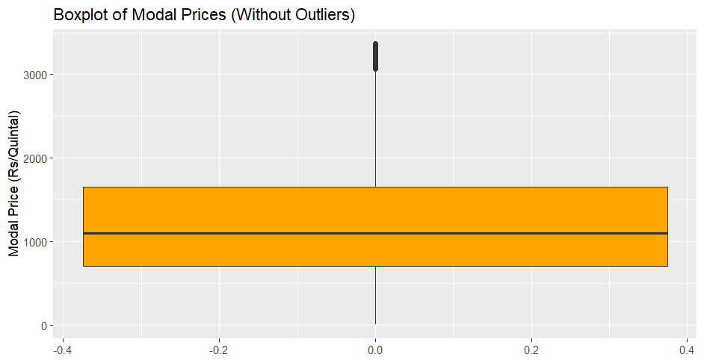
BoxPlot of Numerical Variables
1.Boxplot of Modal Price
1.Most modal prices are concentrated below 2,000 Rs/Quintal, as shown by the narrow box and short whiskers. However, some extreme outliers exceed 60,000 Rs/Quintal, creating a highly skewed distribution.
The modal prices for onions are mostly concentrated between 1,000 and 2,000 Rs/Quintal.
2.A few exceptionally high values (above 3,000 Rs/Quintal) are present as outliers.
The distribution shows a mild right skew, indicating that while most prices are within the normal range, some markets report significantly higher modal prices.

Slide 9
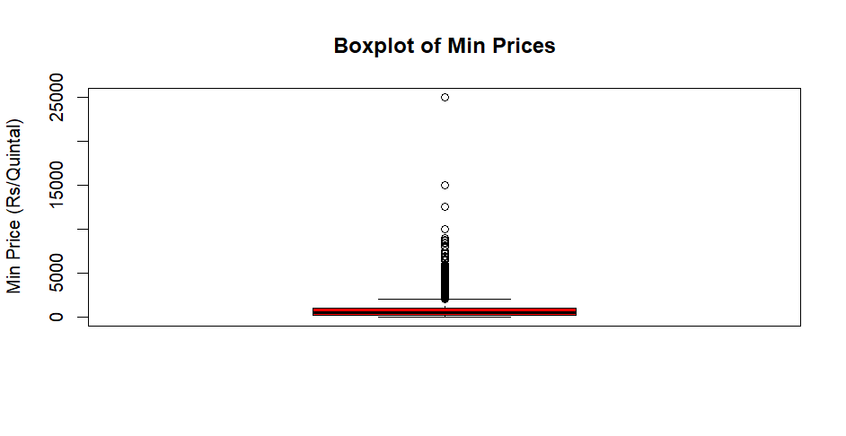
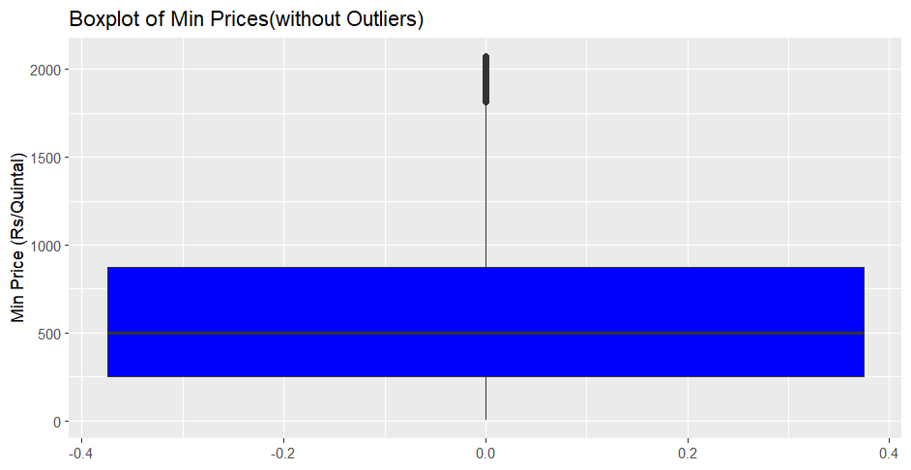
2.Boxplot for Minimum Prices
1.The majority of prices are concentrated below approximately 2,500 Rs/Quintal (indicated by the box), with a median around 1,000 Rs/Quintal. Several outliers are present, indicating a few instances with significantly higher minimum prices, reaching up to 25,000 Rs/Quintal.
Minimum price of onion is 100 Rs/quintal Onion prices fluctuate due to factors like harvest seasons (Kharif: July-October, Rabi: October-March), festivals (Diwali, Holi), supply and demand, and government interventions. Lower prices can occur during harvest seasons, while festivals and seasonal demand can increase prices.
2. The boxplot displays the distribution of minimum prices (Rs/Quintal) after outliers have been removed. The prices are primarily concentrated within a range from approximately 250 to 900 Rs/Quintal (indicated by the blue box), with a median around 500 Rs/Quintal. The whiskers extend to roughly 0 and 2100 with no outliers present beyond these values.

Slide 10
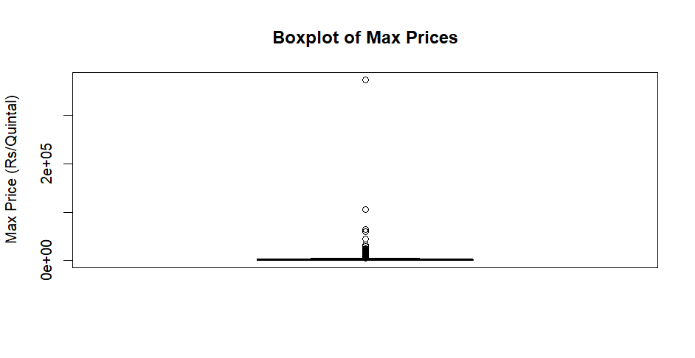
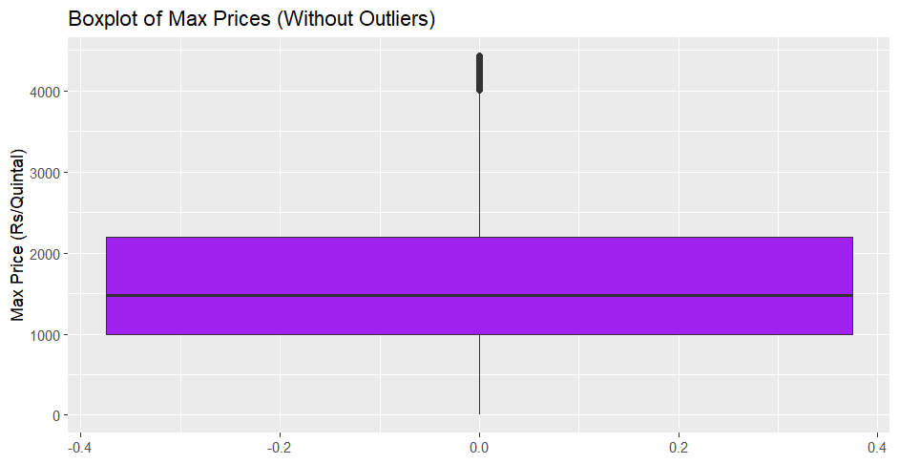
3.Boxplot for Maximum Prices
1.The boxplot shows that the median maximum onion price is around 3000 Rs/Quintal, with the middle 50% of prices clustered within a narrow range. A few outliers indicate the presence of extreme price spikes. The distribution appears slightly skewed to the right, suggesting a few very high prices.
Onion prices can fluctuate due to factors like seasonal supply shortages, particularly during periods when fresh harvests are unavailable. Adverse weather conditions can damage crops, further reducing supply and driving up prices. Additionally, increased demand during festive seasons or social events can strain supply, contributing to higher prices.
2. The boxplot, excluding outliers, reveals a median maximum price around 2000 Rs/Quintal. The middle 50% of prices are clustered within a narrow range, suggesting relatively consistent maximum prices when extreme values are removed. The distribution appears slightly skewed to the right, even without outliers.

Slide 11
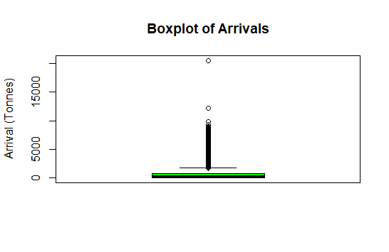
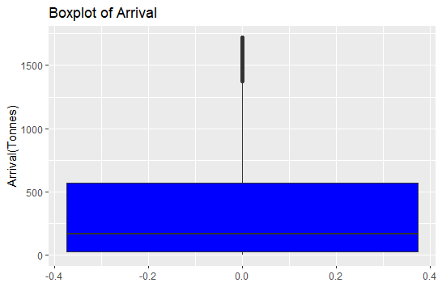
4.Boxplot for Arrivals
1)The boxplot of onion arrivals shows a highly skewed distribution with a majority of values concentrated at low levels and a few extreme outliers exceeding 15,000 tonnes. The presence of these outliers indicates rare but substantial spikes in arrivals, possibly due to unusual market conditions or harvest surges.
2) The boxplot reveals a median arrival of around 200 tonnes. The majority of arrivals fall within a relatively narrow range, suggesting consistent arrival quantities. However, the presence of outliers and the longer whisker on the upper side suggests a right-skewed distribution, indicating that there are instances of significantly higher arrival volumes

Slide 12
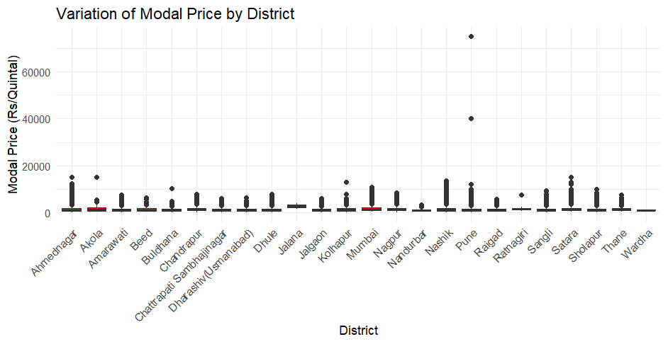
Boxplot of Variation of Modal Price by District
This dot plot illustrates the variation of modal onion prices across different districts. It reveals significant price differences, with some districts having markedly higher modal prices than others. A few districts show outliers with significantly higher prices. This suggests that factors like local supply and demand, transportation costs, and market dynamics likely influence price variations across the region.

Slide 13
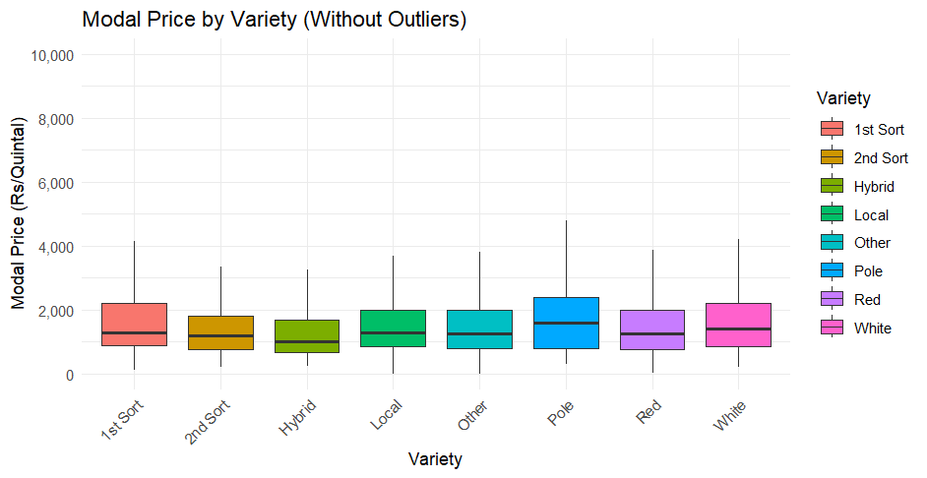
Boxplot of Modal Price by Variety
This box plot illustrates the modal prices of different onion varieties. "1st Sort" and "White" varieties generally have higher median prices compared to others. The spread of prices is relatively similar across most varieties. The presence of whiskers and potential outliers suggests that extreme price points might exist for some varieties. This highlights the significant influence of variety on onion prices

Slide 14
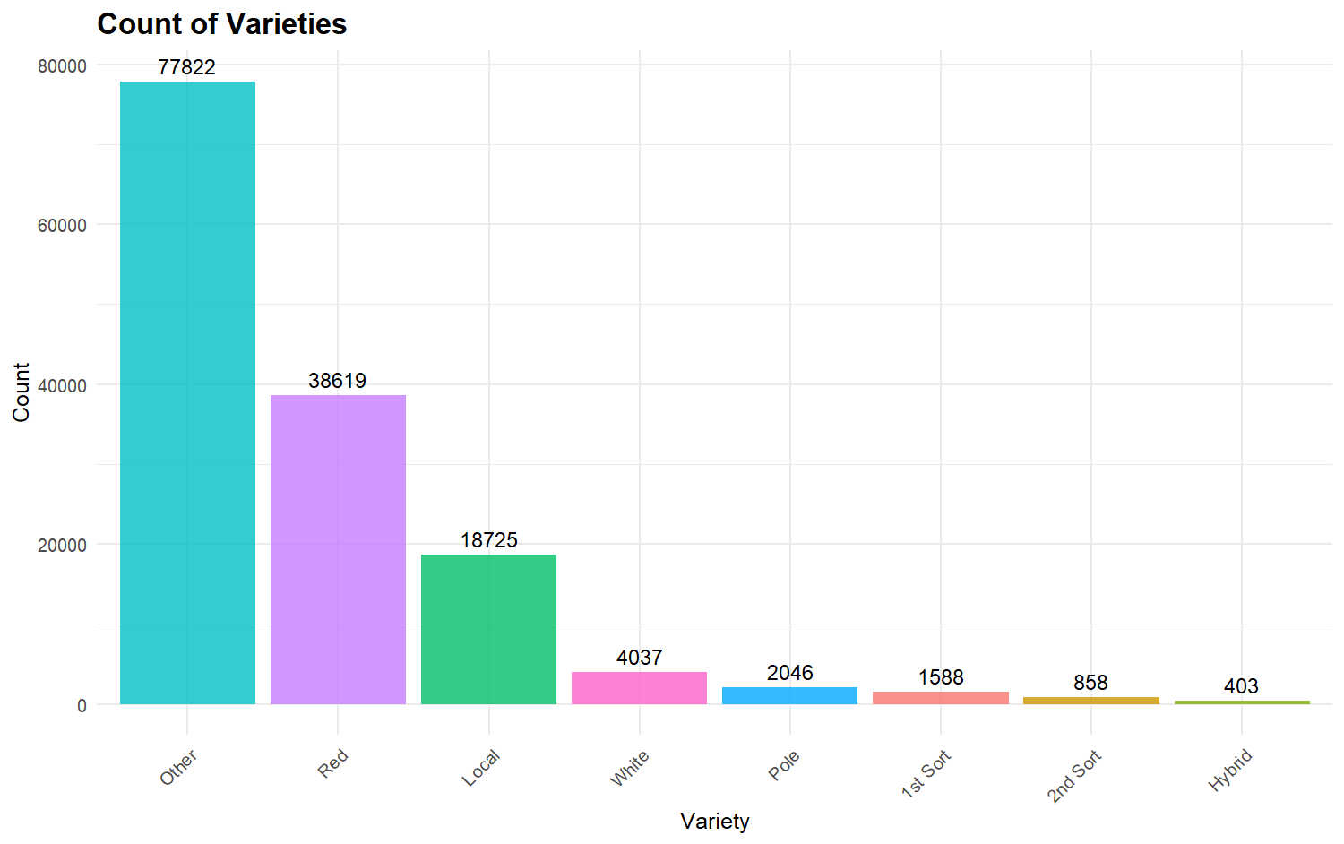
Bar plot for Variety
The bar chart shows the distribution of different onion varieties. "Other" is the most frequent variety, followed by "Red" and "Local." The counts generally decrease from "Other" to "Hybrid," suggesting that "Hybrid" is the least common variety. This chart provides insights into the market share of different onion varieties.

Slide 15
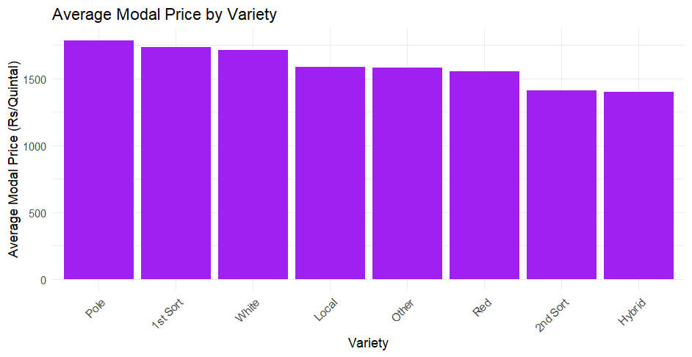
Bar plot for average modal price by Variety
This bar chart illustrates the average modal price (most frequent price) for different onion varieties. "Pole" onions have the highest average modal price, followed by "1st Sort" and "White". "Hybrid" onions have the lowest average modal price. This suggests that certain varieties command higher prices in the market, likely due to factors like quality, demand, and market segmentation.

Slide 16
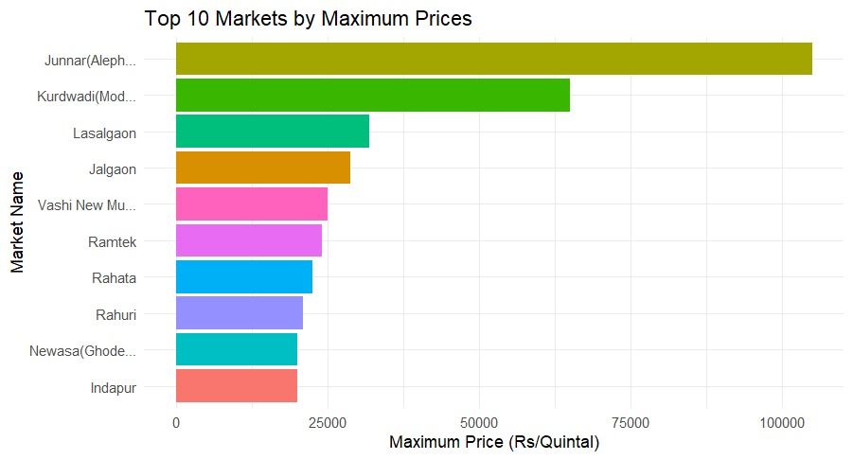
Bar plot of top 10 Markets By Maximum Prices
The plot illustrates the top 10 markets with the highest maximum onion prices. Junnar(Alephata) commands the highest price at around 100,000 Rs/Quintal, while Indapur reports the lowest price at approximately 20,000 Rs/Quintal.

Slide 17
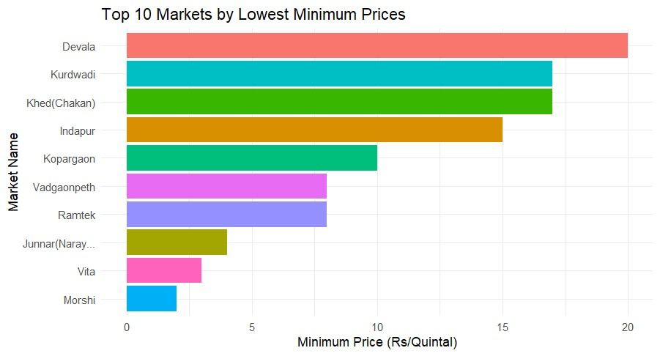
Top 10 markets by Lowest Minimum Prices
The plot shows the top 10 markets with the lowest minimum onion prices, with Devala having the lowest price at around 20 Rs/Quintal, and Morshi having the highest price at around 1 Rs/Quintal

Slide 18
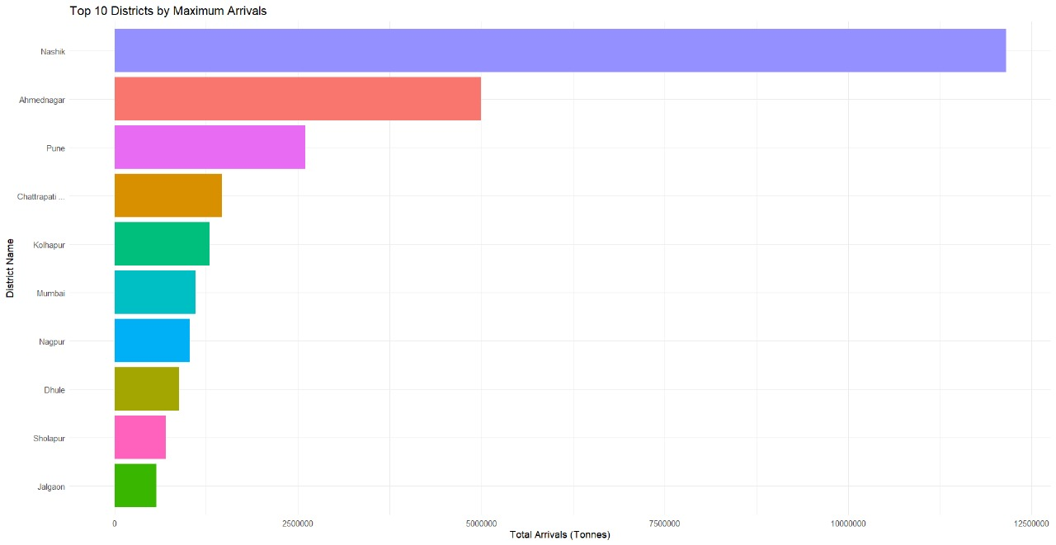
Top 10 Districts by Max Arrivals
This plot shows the top 10 districts in Maharashtra based on maximum onion arrivals. Nashik emerges as the district with the highest onion arrivals, followed by Ahmednagar and Pune. This information can be valuable for understanding regional onion production and distribution patterns.

Slide 19
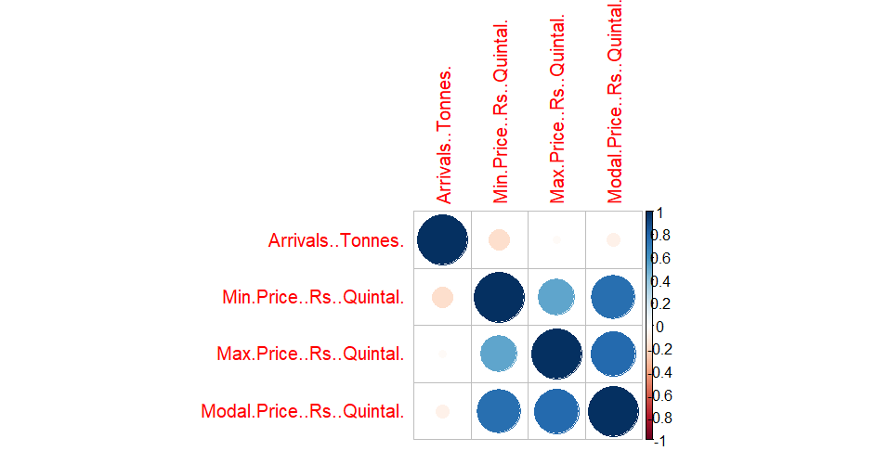
Correlation Plot
This correlation plot visualizes the relationships between four variables: Arrivals (Tonnes), Minimum Price, Maximum Price, and Modal Price. Darker blue circles indicate a stronger positive correlation, while lighter blue circles suggest a weaker correlation. The plot reveals high correlations between all four variables, suggesting that they are closely interconnected.

Slide 20
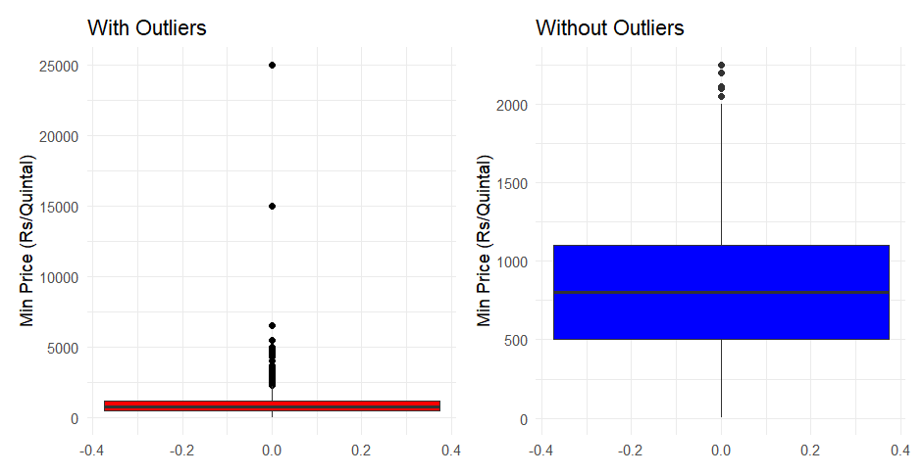
Boxplot For Minimum Prices (Pune)
The boxplot shows the distribution of minimum onion prices, including outliers. The median price is around 1500 Rs/Quintal. Most prices are clustered lower, while several outliers indicate significantly higher minimum prices. This suggests a right-skewed distribution, with a longer tail on the right side
The boxplot shows the distribution of minimum prices after removing outliers. The median remains around 1500 Rs/Quintal. The box is shorter, indicating a narrower range for the middle 50% of prices, suggesting that outliers significantly influenced the overall spread of the data. The distribution appears less skewed compared to the boxplot with outliers.

Slide 21
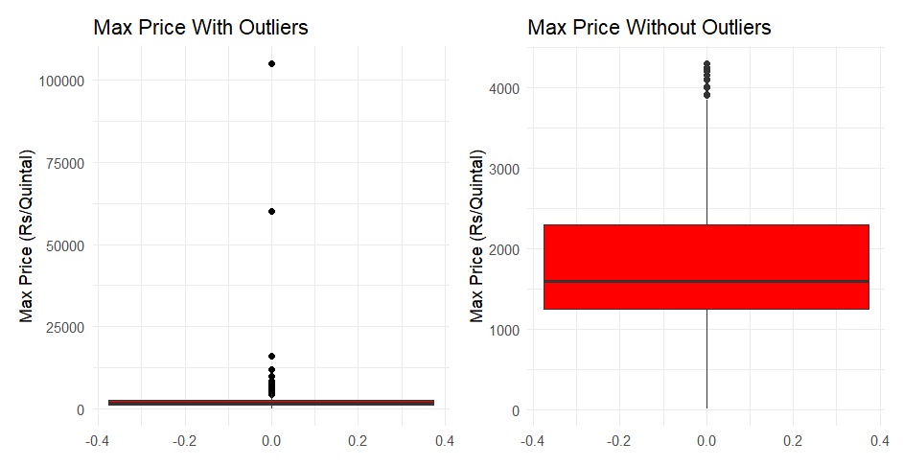
Boxplot For Maximum Prices (Pune)
The boxplot shows the distribution of maximum onion prices, including outliers. The median price is around 2500 Rs/Quintal. Most prices are clustered lower, while several outliers indicate significantly higher maximum prices. This suggests a right-skewed distribution, with a longer tail on the right side.
The boxplot shows the distribution of maximum prices after removing outliers. The median price is around 2000 Rs/Quintal. The box is shorter, indicating a narrower range for the middle 50% of prices. This suggests that outliers significantly influenced the overall spread of the data. The distribution appears less skewed compared to the boxplot with outliers.

Slide 22
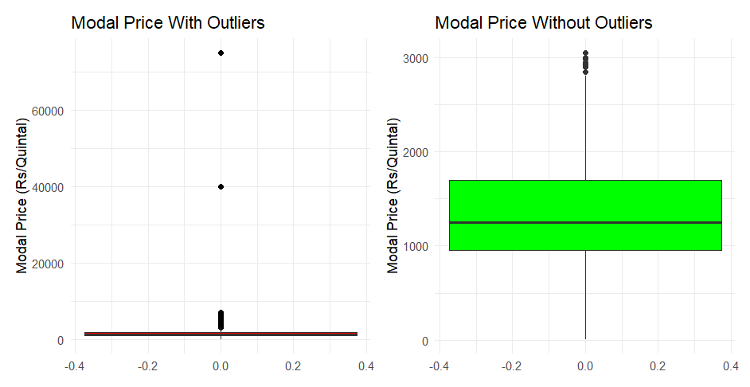
Boxplot For Modal Prices (Pune)
The boxplot shows the distribution of modal onion prices, including outliers. The median price is around 1000 Rs/Quintal. Most prices are clustered lower, while several outliers indicate significantly higher modal prices. This suggests a right-skewed distribution, with a longer tail on the right side.
The boxplot shows the distribution of modal prices after removing outliers. The median price remains around 1000 Rs/Quintal. The box is shorter, indicating a narrower range for the middle 50% of prices. This suggests that outliers significantly influenced the overall spread of the data, likely reducing the right-skewness of the distribution.

Slide 23
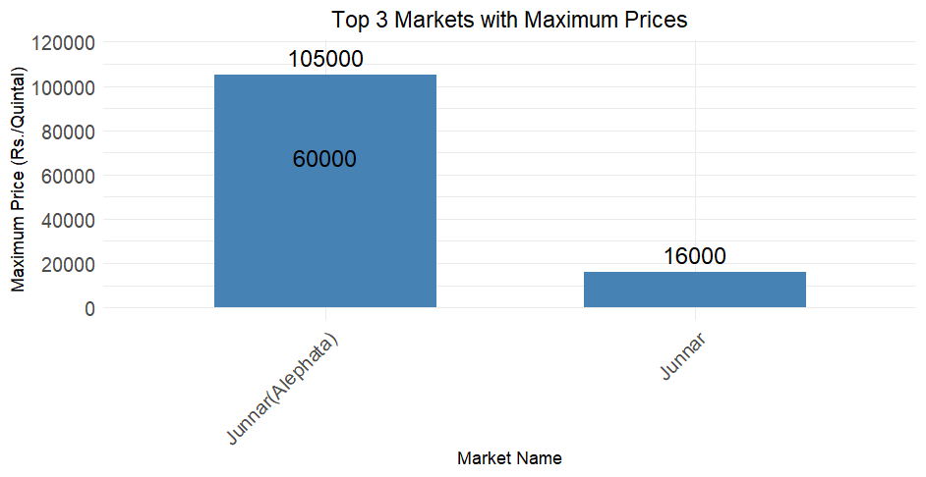
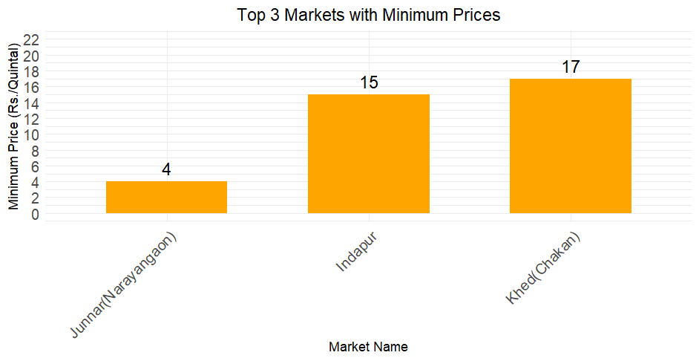
Top 3 Markets with Maximum Minimum Prices
1)The plot reveals that Junnar(Alephata) exhibits the highest maximum onion price at approximately 105,000 Rs/Quintal, followed by Junnar at 16,000 Rs/Quintal.
2)The plot illustrates the top 3 markets with the minimum onion prices, with Junnar(Narayangaon) at 4 Rs/Quintal, Indapur at 15 Rs/Quintal, and Khed(Chakan) at 17 Rs/Quintal.

Slide 24
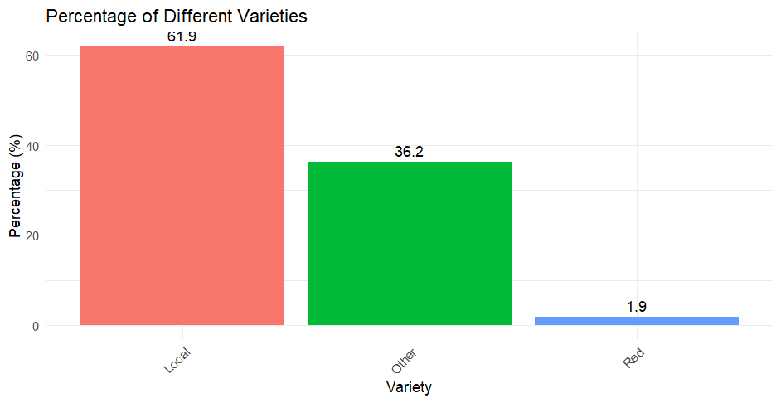
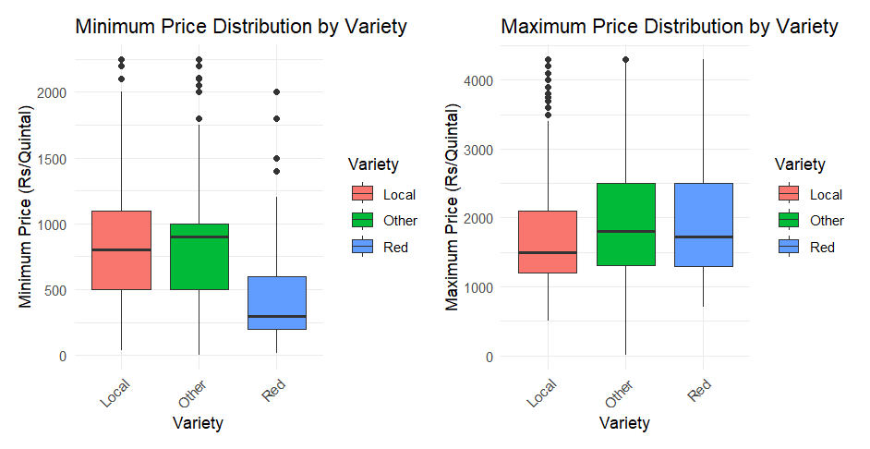
Bar Plot Calculate counts and percentages
Box Plot of Max and Min Price by Variety
1)The plot shows that Local variety of onions constitutes 61.9% of the total, followed by Other variety at 36.2%, and Red variety at a negligible 1.9%.
2)The boxplots show that "Local" onions generally have the lowest minimum and maximum prices compared to "Other" and "Red" varieties. The "Red" variety exhibits the widest range of prices, with some having very high maximum prices.

Slide 25
Comparison of Prices & Arrivals of Pre and Post Covid Period and During covid Period
We divide the whole dataset into two parts, pre covid-19 (1-1-2013 to 23-3-2020) and remaining as post covid-19 (15-6-2021 to 31-12-2024) . we compare the prices after covid and before covid. And during Covid-19 Period. Also we use Welch t test for comparison
In Maharashtra, the lockdown periods during the COVID-19 pandemic were as follows:
First Lockdown: March 23, 2020 – June 1, 2020
Second Lockdown: April 15, 2021 – June 15, 2021
Welch’s t-test:
Welch’s t-test is a statistical method used to compare the means of two independent groups when the assumption of equal variances (homoscedasticity) is violated. Unlike the traditional Student’s t-test, Welch’s t-test is more robust as it does not require the variances of the two groups to be equal. This makes it particularly useful in real-world scenarios where group variances and sample sizes often differ.
Hypotheses:
Null Hypothesis (H0​): There is no difference in the population means
Alternative Hypothesis (Ha​): There is a difference in the population means
We reject null hypothesis when p value <0.05

Slide 26
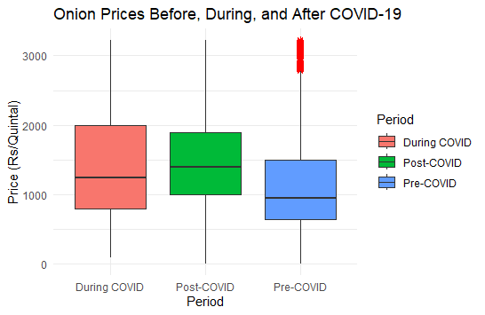
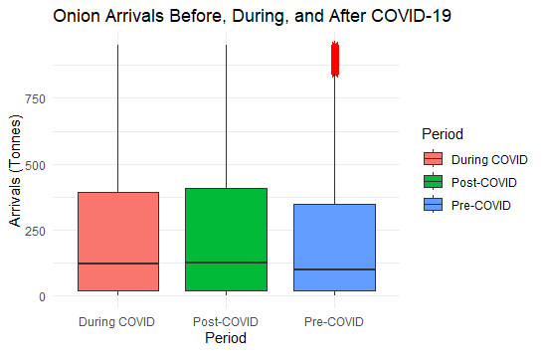
Boxplots of Onion Prices & Arrivals Before, During, and After Covid-19
The boxplot shows that onion prices increased steadily across the three periods. Pre-COVID prices were the lowest with high variability and extreme outliers. During COVID, prices rose significantly, showing moderate variability. Post-COVID prices were the highest with slightly reduced variability. This comparison highlights a consistent upward trend, reflecting disruptions and market adjustments over time.
The boxplot shows onion arrivals (in tonnes) across the three periods. Pre-COVID arrivals were the most variable, with high values and extreme outliers. During COVID, arrivals slightly increased with moderate variability. Post-COVID, arrivals declined significantly with reduced variability. This comparison highlights a decrease in arrivals from pre-COVID to post-COVID, likely reflecting supply chain disruptions and market constraints during and after COVID.

Slide 27
Welch's- Test For Prices & Arrivals Comparison
T- Test For Price Comparison :
T-Test: During COVID vs Pre-COVID
The mean onion price during COVID (₹1454/quintal) was significantly higher than pre-COVID (₹1152/quintal). p-value is < 2.2e-16, indicating a statistically significant difference. COVID had a significant impact, leading to a price increase.
T-Test: During COVID vs Post-COVID
The mean price during COVID (₹1454/quintal) was slightly lower than post-COVID (₹1506/quintal). p-value is 1.42e-12, indicating a statistically significant difference.
Prices remained high post-COVID but with a small upward shift compared to during COVID.
T- Test For Arrivals Comparison :
Two Welch t-tests were conducted:
During COVID vs. Pre-COVID: The mean arrivals during COVID (233 tonnes) were significantly higher than Pre-COVID (217 tonnes), with a p-value of 6.15×10−9, indicating a statistically significant difference.
During COVID vs. Post-COVID: The mean arrivals during COVID (233 tonnes) were significantly lower than Post-COVID (241 tonnes), with a p-value of 0.003, showing a statistically significant difference.

Slide 28
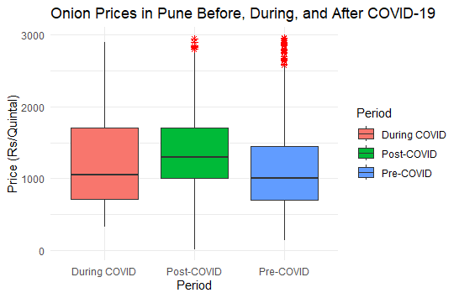
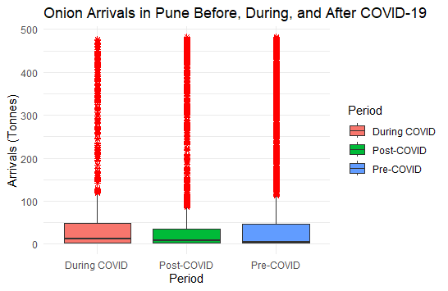
Prices & Arrivals Comparison for Pune District
1) This box plot compares onion prices in Pune across three periods: pre-COVID, during COVID, and post-COVID. The median price appears to have increased during the COVID period compared to pre-COVID. While the median decreased post-COVID, it remains higher than the pre-COVID period. The presence of outliers suggests significant price fluctuations within each period
2) This box plot compares onion arrivals in Pune across three periods: pre-COVID, during COVID, and post-COVID. The median arrival quantity appears to be highest during the COVID period, followed by the post-COVID period, and then the pre-COVID period. The presence of numerous outliers suggests significant variability in arrival quantities within each period.

Slide 29
T Test For Prices Comparison :
During COVID vs Pre-COVID: The mean price during COVID (₹1264.79/quintal) was significantly higher than pre-COVID (₹1134.55/quintal) with a p-value of 1.249e-11.
During COVID vs Post-COVID: The price during COVID (₹1264.79/quintal) was significantly lower than post-COVID (₹1413.93/quintal) with a p-value of 1.913e-15.
Onion prices increased significantly from pre-COVID to during COVID, then further rose post-COVID.
T Test For Arrivals Comparison:
During COVID vs Pre-COVID: The mean arrivals during COVID (66.58 tonnes) are slightly higher than pre-COVID (64.30 tonnes), but the p-value (0.5759) indicates no statistically significant difference.
During COVID vs Post-COVID: The mean arrivals during COVID (66.58 tonnes) are significantly higher than post-COVID (39.76 tonnes), with a p-value of 1.446e-12, indicating a statistically significant difference.
There was no significant difference in arrivals between during COVID and pre-COVID, but there was a significant increase in arrivals during COVID compared to post-COVID

Slide 30
Time series analysis :
The objective of doing time series is to forecast Modal Price of onion using historical data
For forecasting Modal Prices we used data of monthly Modal price from 2013January to December 2024.
The data sets available in the current work are univariate and seasonal.
For such data sets and short-term forecast, seasonal ARIMA and Holt-Winter’s method are used for forecasting.

Slide 31
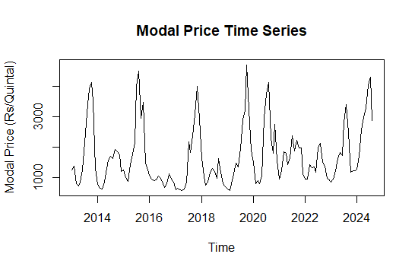
SARIMA
1.Time series plot
The plot reveals a cyclical pattern in onion prices, with recurring peaks and troughs over roughly two-year intervals. The prices exhibit significant volatility, fluctuating rapidly between highs and lows. The series appears to be non-stationary due to variations in the mean and variance over time.

Slide 32
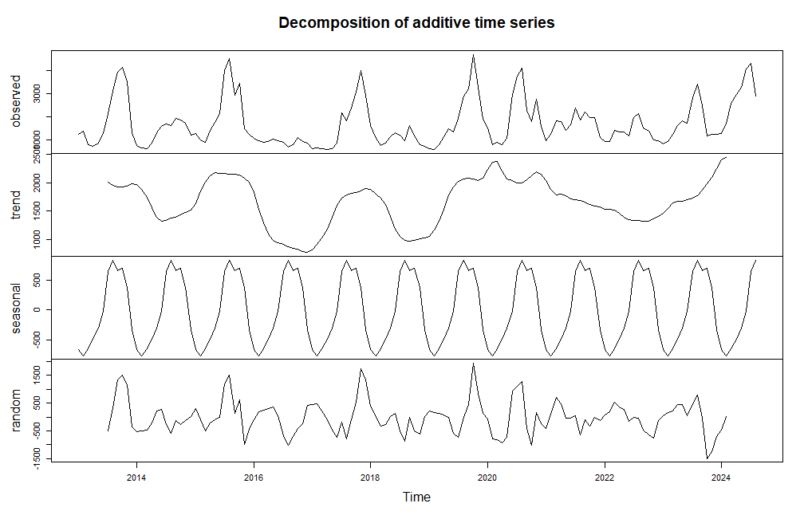
Decomposition of Time series
The plot decomposes the onion price series into its constituent components: trend, seasonality, and random noise. The trend component shows a cyclical pattern with a period of roughly two years. Seasonality appears to have a shorter-term cycle, while the random noise component captures unpredictable fluctuations. This decomposition helps understand the drivers of price variations and aids in forecasting.

Slide 33
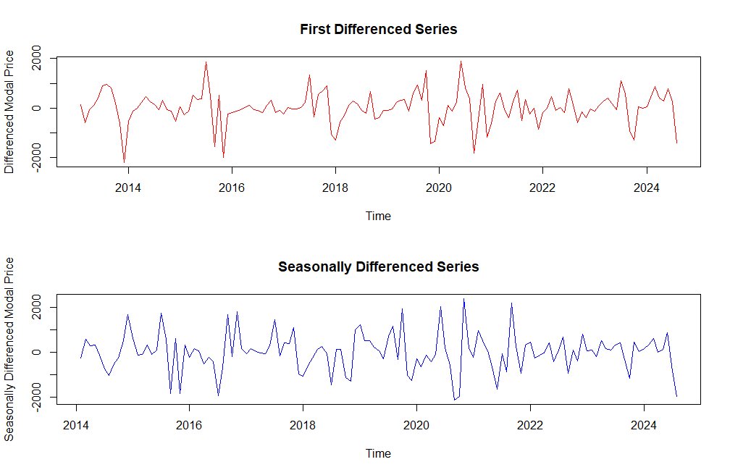
1. First Differenced Series:
This plot shows the result of differencing the original onion price time series.
Differencing helps to reduce volatility and dampen the cyclical patterns.
2. Seasonally Differenced Series:
This plot shows the result of seasonal differencing.
Seasonal differencing effectively removes the seasonal component, leaving a more stationary-looking series.

Slide 34
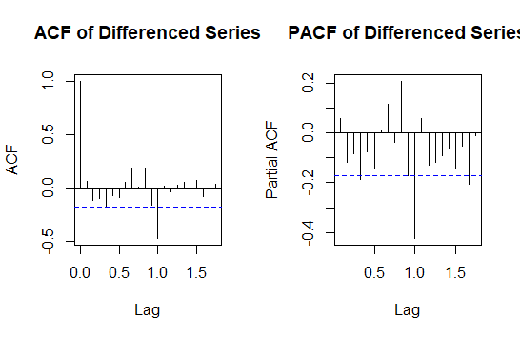
ACF and PACF
The ACF and PACF plots indicate that an AR(1) model might be appropriate for modeling the differenced time series. This information can be used to select the appropriate parameters for an ARIMA model to forecast the original time series.

Slide 35
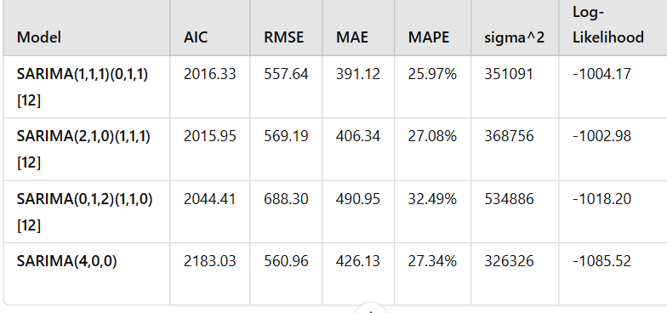
Fitting a Model and selecting the best
The SARIMA(2,1,0)(1,1,1) model is the best fit for the data due to its lowest AIC (2015.95), indicating optimal model selection. While its RMSE and MAE are slightly higher than SARIMA(1,1,1)(0,1,1)[12], it provides a better balance between accuracy and complexity.

Slide 36
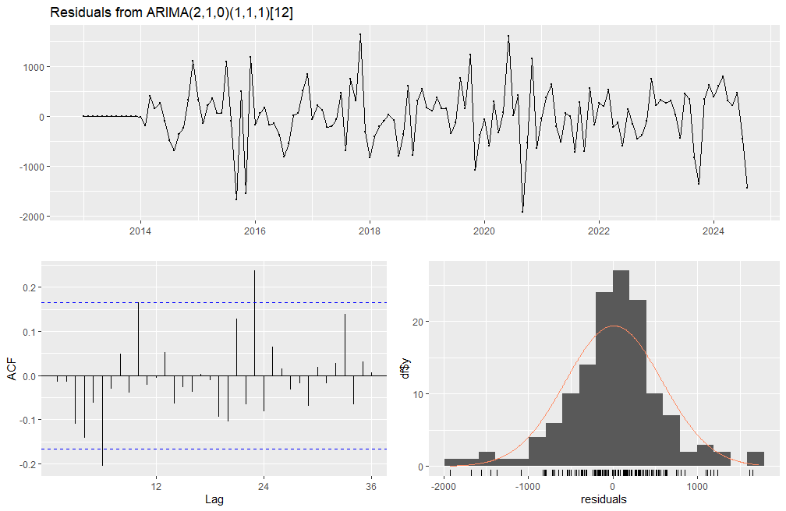
Residual Diagnosis for model
The top plot shows the residuals from an ARIMA(2,1,0)(1,1,1)[12] model. The ACF plot of the residuals indicates that the model has captured most of the autocorrelation in the data, as there are no significant spikes. The histogram and density plot suggest that the residuals are approximately normally distributed, which is a key assumption for many time series models.

Slide 37
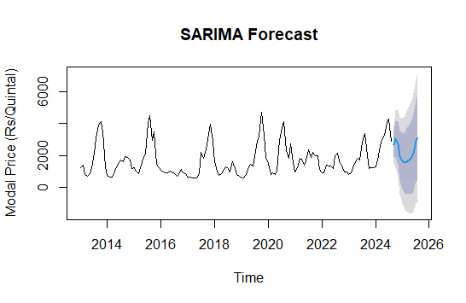
Sarima forecast
This plot shows the forecasted modal onion prices using a SARIMA model. The blue line represents the point forecast, while the shaded area represents the prediction interval, indicating the uncertainty associated with the forecast. The forecast suggests a potential increase in modal prices in the near future.

Slide 38
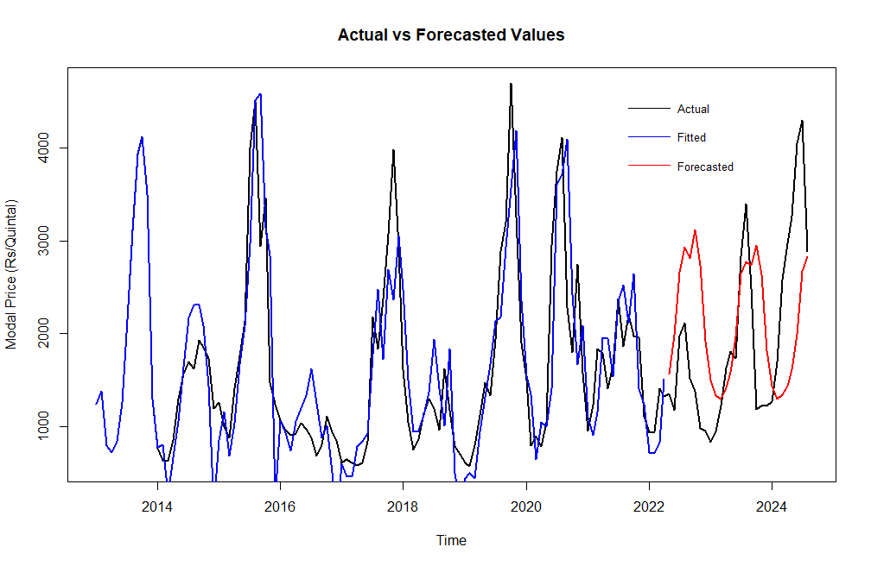
Time series Actual and fitted values plot
The fitted values closely align with actual prices, demonstrating the model's ability to capture trends and seasonality

Slide 39
Holt winters multiplicative model
The Holt-Winters multiplicative model is a popular method for forecasting time series data that exhibits both trend and seasonality. This method is based on exponential smoothing and assumes that the seasonal variations in the data change proportionally (multiplicatively) with the trend.

Slide 40
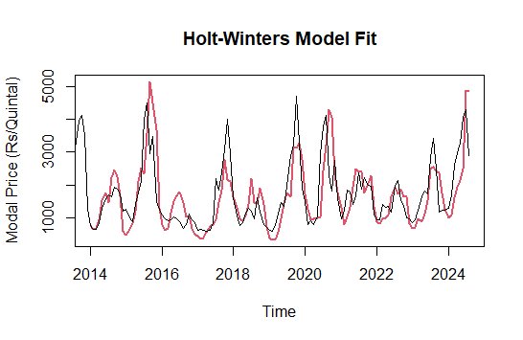
Actual and Fitted value plot
The Holt-Winters model demonstrates strong performance in capturing the seasonal patterns and overall trend in modal onion prices from 2013 to 2024.

Slide 41
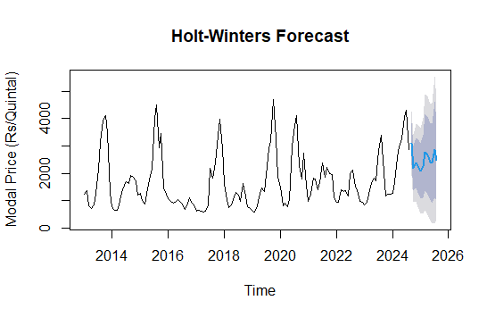
Forecast plot for Holt winters
The Holt-Winters forecast accurately captures historical seasonality and trends, with reliable short-term predictions (2025-2026).

Slide 42
Conclusions
1)During COVID, onion arrivals increased compared to pre-COVID but were lower than post-COVID levels , reflecting supply chain recovery. Prices significantly rose during COVID and remained slightly higher post-COVID indicating lasting pandemic effects on supply and pricing.
2)Onion prices significantly increased from pre-COVID to during COVID and further rose post-COVID, reflecting sustained price effects. While there was no significant change in arrivals between pre-COVID and during COVID, arrivals during COVID were significantly higher than post-COVID, indicating supply chain adjustments post-pandemic.( Pune District)
3) The SARIMA model forecast indicates a slight increase in onion prices for 2025–2026, continuing the observed seasonal trends from historical data. The forecast captures seasonal patterns effectively, with confidence intervals showing increasing uncertainty over time.
4) The Holt-Winters model effectively captures the seasonality and trends in onion prices, providing reliable short-term forecasts (2025–2026).
5) The SARIMA (2,1,0)(1,1,1) model is the better choice. It offers superior fit, can handle complex seasonality, and is likely to provide better forecast accuracy than the Holt-Winters model.

Slide 43
Limitations and Future scope
We have very few variables for analysis, so only time series analysis is conducted.
Only secondary data analysis is performed; primary data was not collected for analysis
Future research should delve into the impact of weather patterns (rainfall, temperature) and input costs (fertilizers, pesticides, labor) on onion production and prices. Additionally, analyzing the impact of government policies, such as import/export restrictions and market interventions, on price stability and market dynamics is crucial.

Slide 44
THANK YOU!!!

